Slide 1
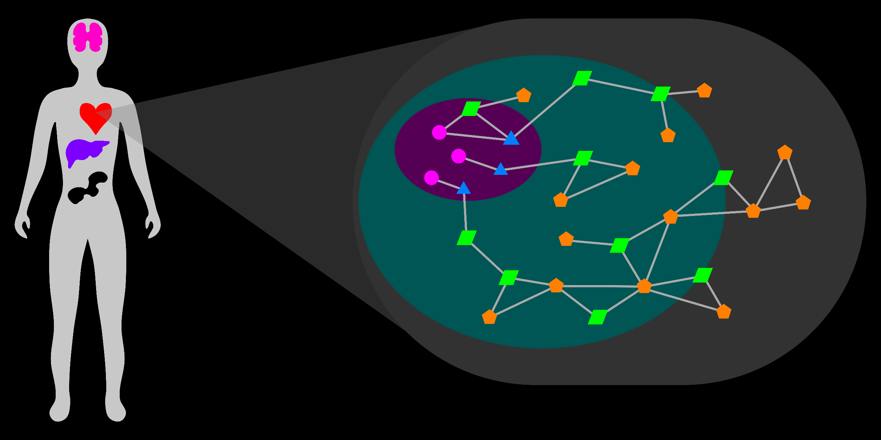
Visual Exploration and Analysis of the Metabolic Network
Department Of Biochemistry
Research Seminar
15 September 2016
T Cameron Waller

Slide 2

Holistic Study Of Metabolism
1) Consider all known connections.
2) Discover new connections.
Avoid arbitrary bias.
Connections may be:
Atypical
Compensatory
Subtle
Connections may be:
Novel
Case-Specific (Disease)

Slide 3
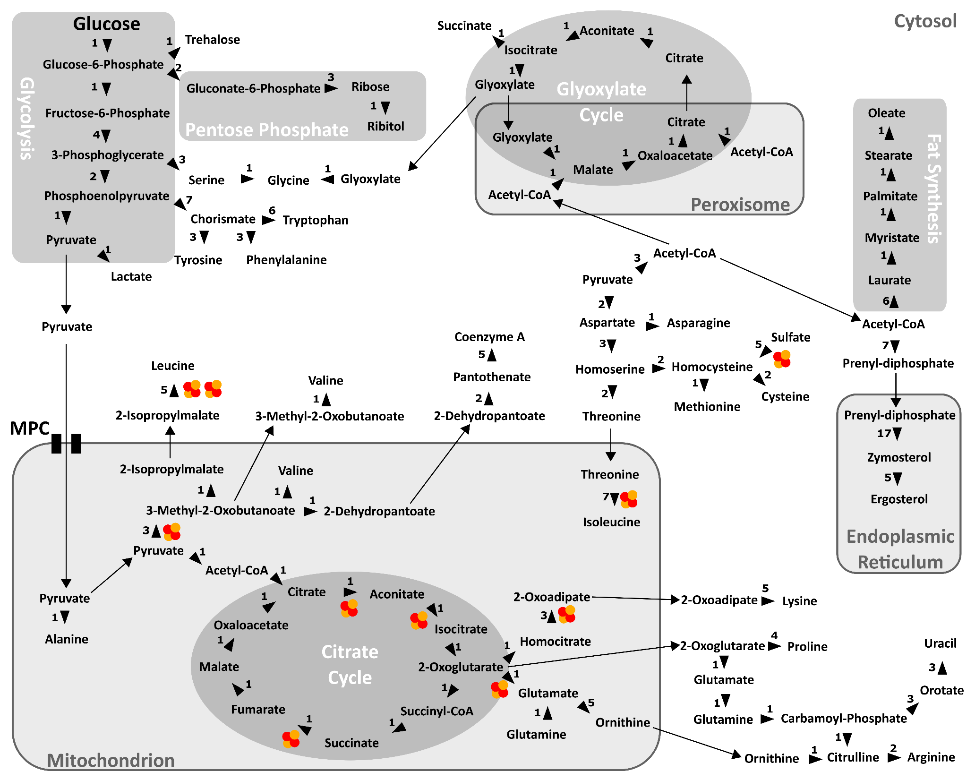

Slide 4
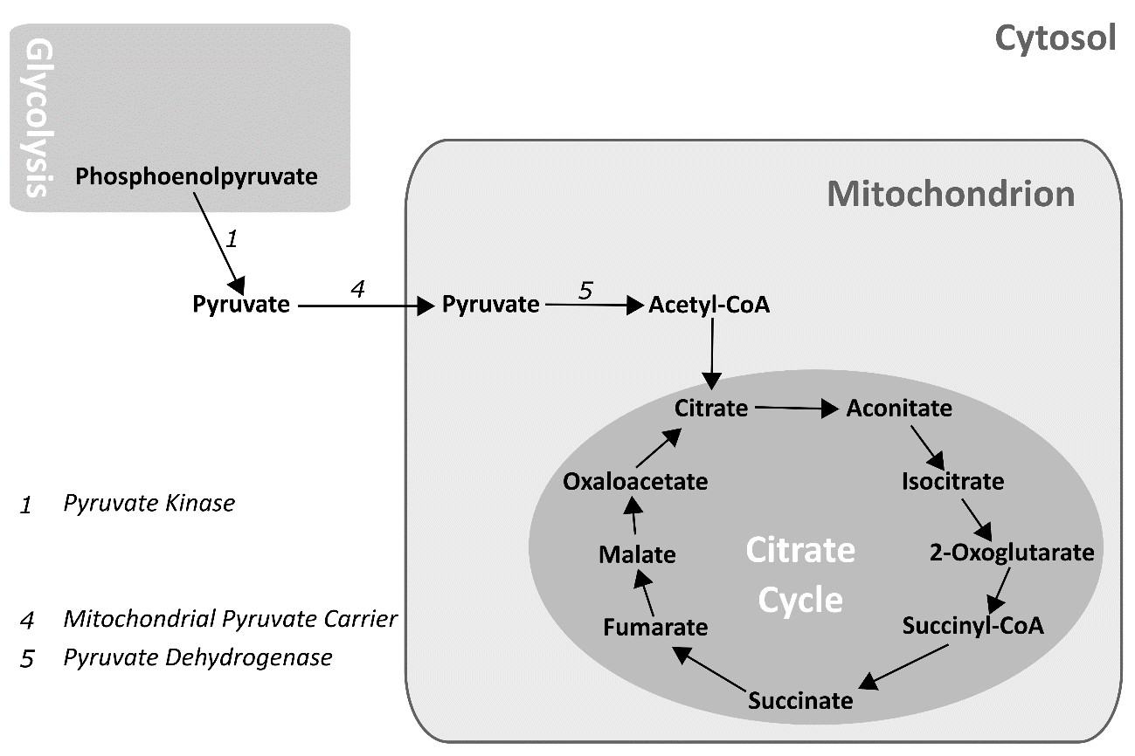
Holistic Study Of Metabolism
1) Consider all known connections.
Avoid arbitrary bias.
Connections may be:
Atypical
Compensatory
Subtle

Slide 5
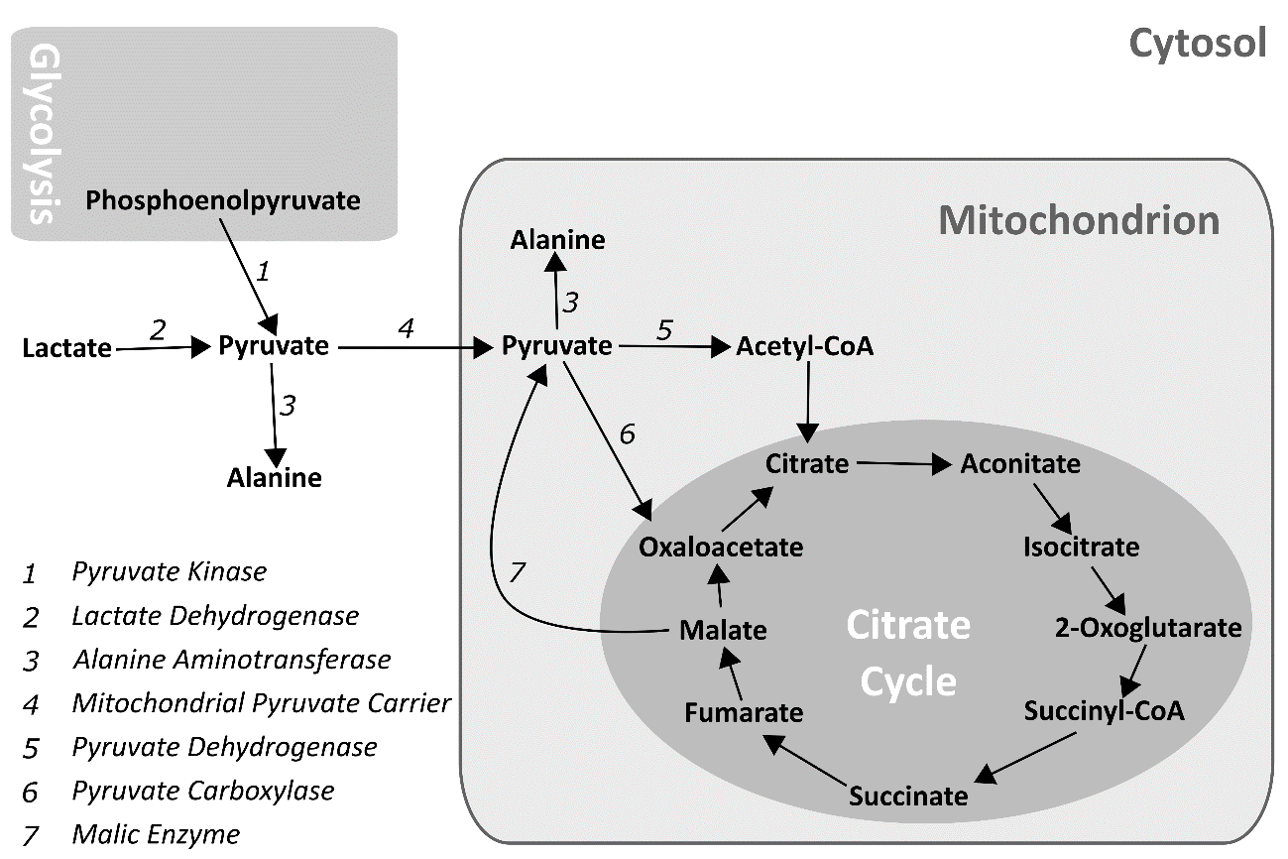
Holistic Study Of Metabolism
1) Consider all known connections.
Avoid arbitrary bias.
Connections may be:
Atypical
Compensatory
Subtle

Slide 6
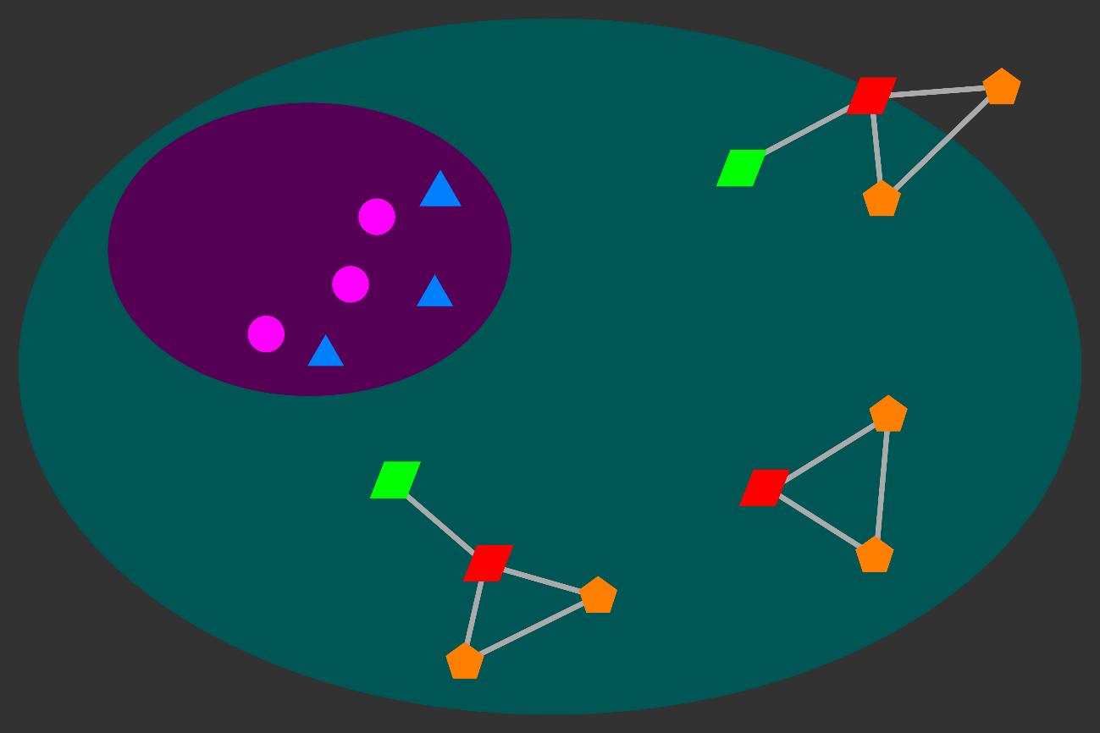
Holistic Study Of Metabolism
1) Consider all known connections.
2) Discover new connections.
Avoid arbitrary bias.
Connections may be:
Atypical
Compensatory
Subtle
Connections may be:
Novel
Case-Specific (Disease)

Slide 7
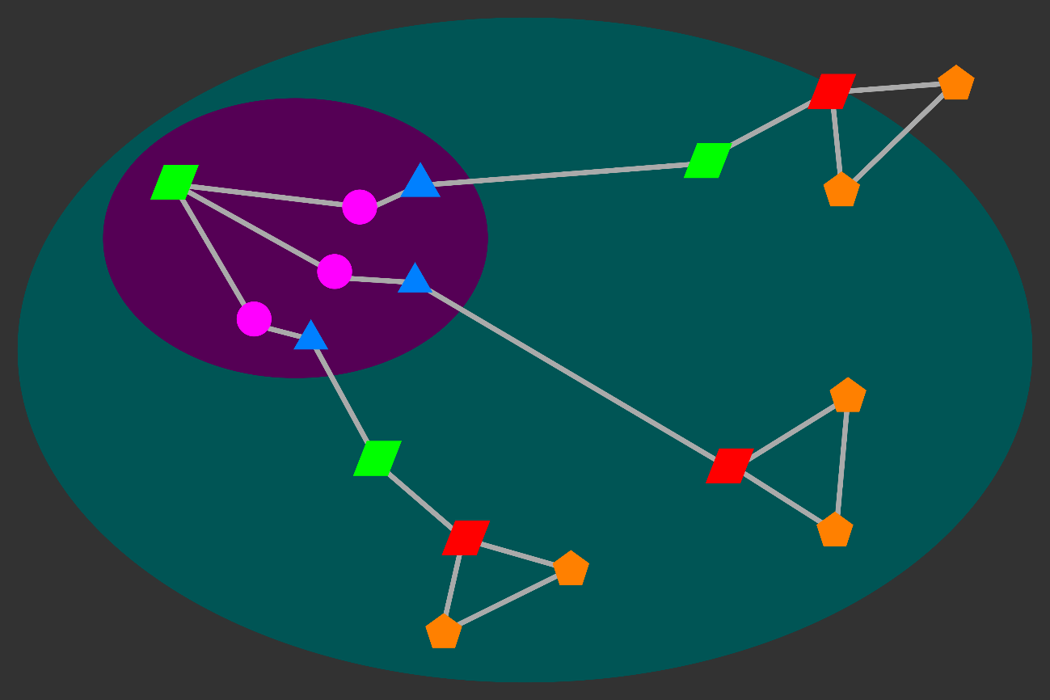
Holistic Study Of Metabolism
1) Consider all known connections.
2) Discover new connections.
Avoid arbitrary bias.
Connections may be:
Atypical
Compensatory
Subtle
Connections may be:
Novel
Case-Specific (Disease)

Slide 8
Metabolic Network: Entities (Nodes)
Entities:
Genes
Transcripts
Proteins
Metabolites
~ 70,000
> 70,000
~ 30,000
~ 30,000
Attributes:
Abundance
Compartment
Modification
Cofactor

Slide 9
Metabolic Network: Relations (Links)
Entities:
Genes
Transcripts
Proteins
Metabolites
~ 70,000
> 70,000
~ 30,000
~ 30,000
Relations:
Encoding:
Attributes:
Metabolic Pathway
Expression:
Anabolism/Catabolism
Reduction/Oxidation
Regulation:
Reaction Rate
Transport:
Catalysis:
Reaction:
Notes:
--Entities: Genes, Transcripts, Proteins, Metabolites
--Relations:
---Encoding: Biological Sequences, Genetic Code (Gene-Transcript-Protein)
---Expression: Regulation of transcription and translation (Metabolite-Protein, Protein-Gene, Protein-Transcript)
---Regulation: Allosteric regulation (Metabolite-Protein), Post-translational modification of proteins (Protein-Protein)
---Transport: Metabolite transport (Protein-Metabolite)
---Catalysis: Enzymatic catalysis (Protein-Metabolite)
---Reaction: Chemical reactions (Metabolite-Metabolite)

Slide 10
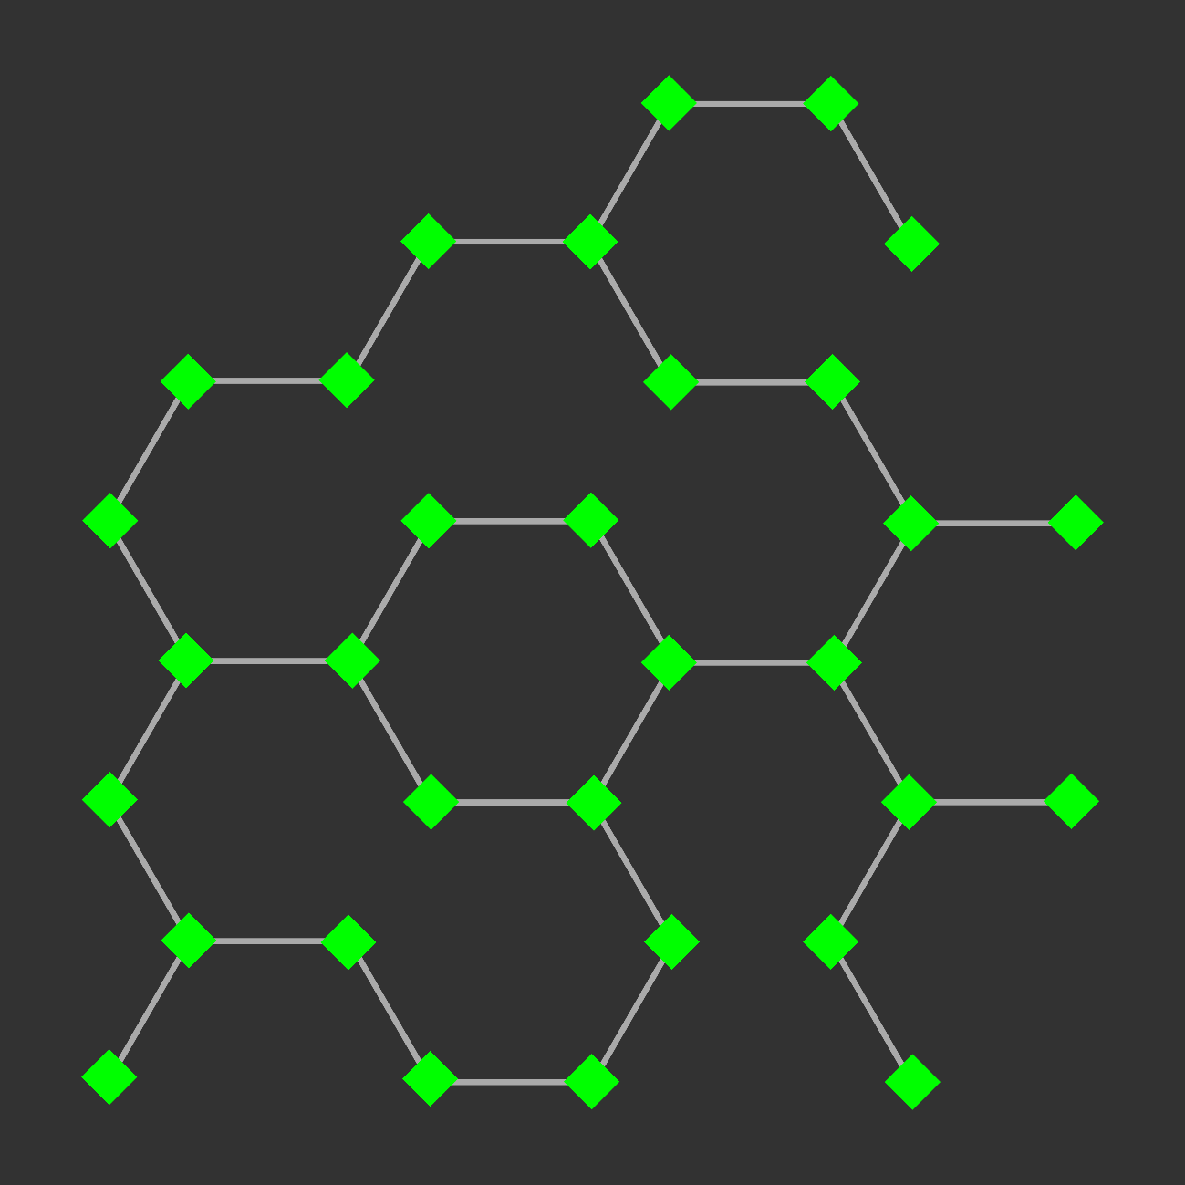
Network Visualization: Exploration And Analysis

Slide 11
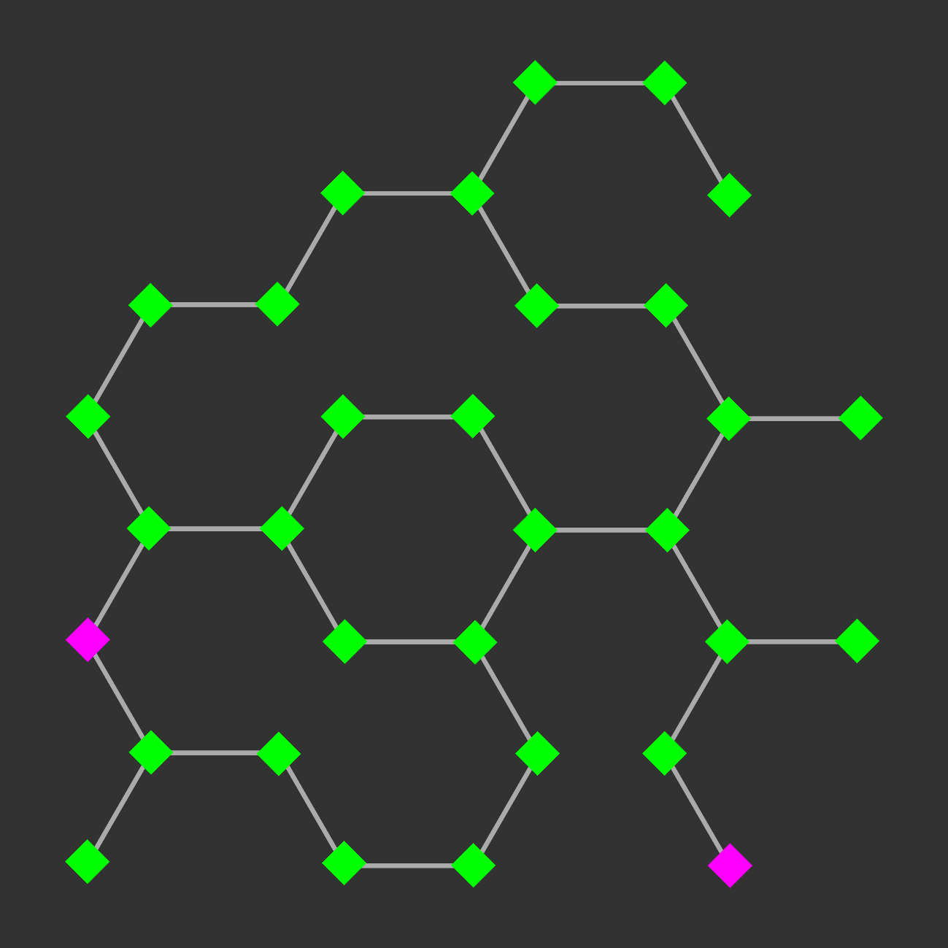
Network Visualization: Exploration And Analysis
Find paths between nodes:
- Shortest path

Slide 12
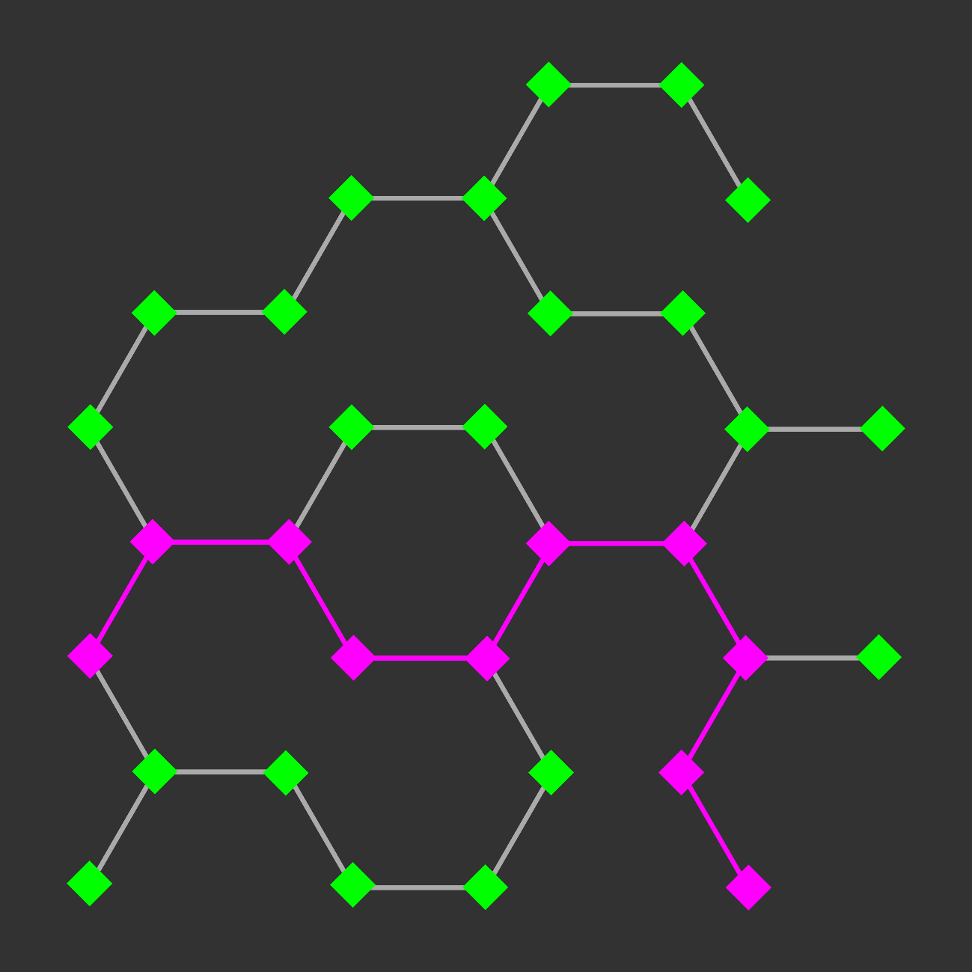
Network Visualization: Exploration And Analysis
Find paths between nodes:
- Shortest path

Slide 13
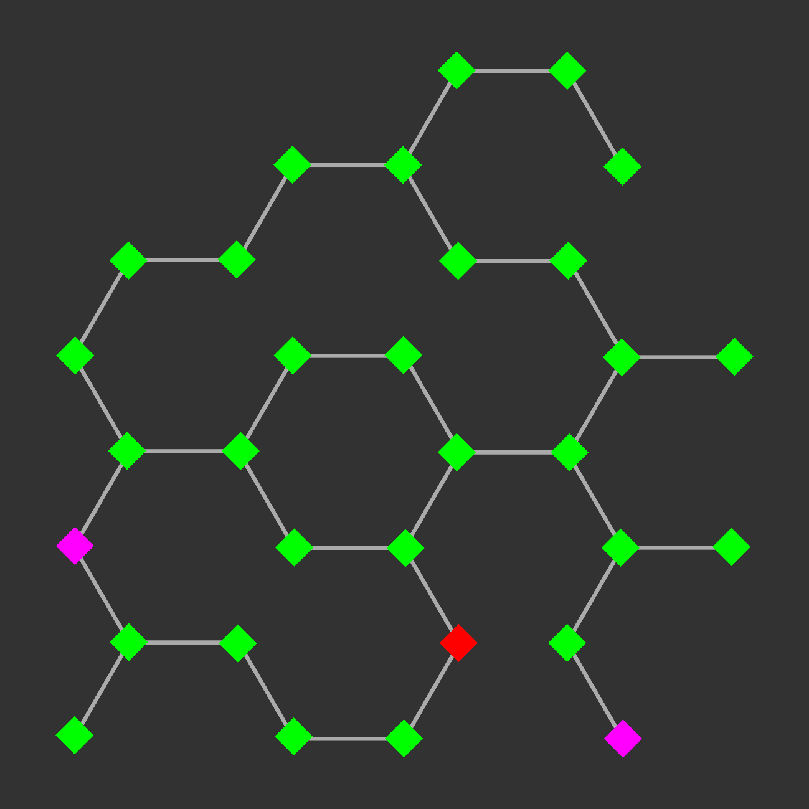
Network Visualization: Exploration And Analysis
Find paths between nodes:
- Shortest path
- Shortest path including or excluding another node or classification
- Path with greatest flux rate

Slide 14
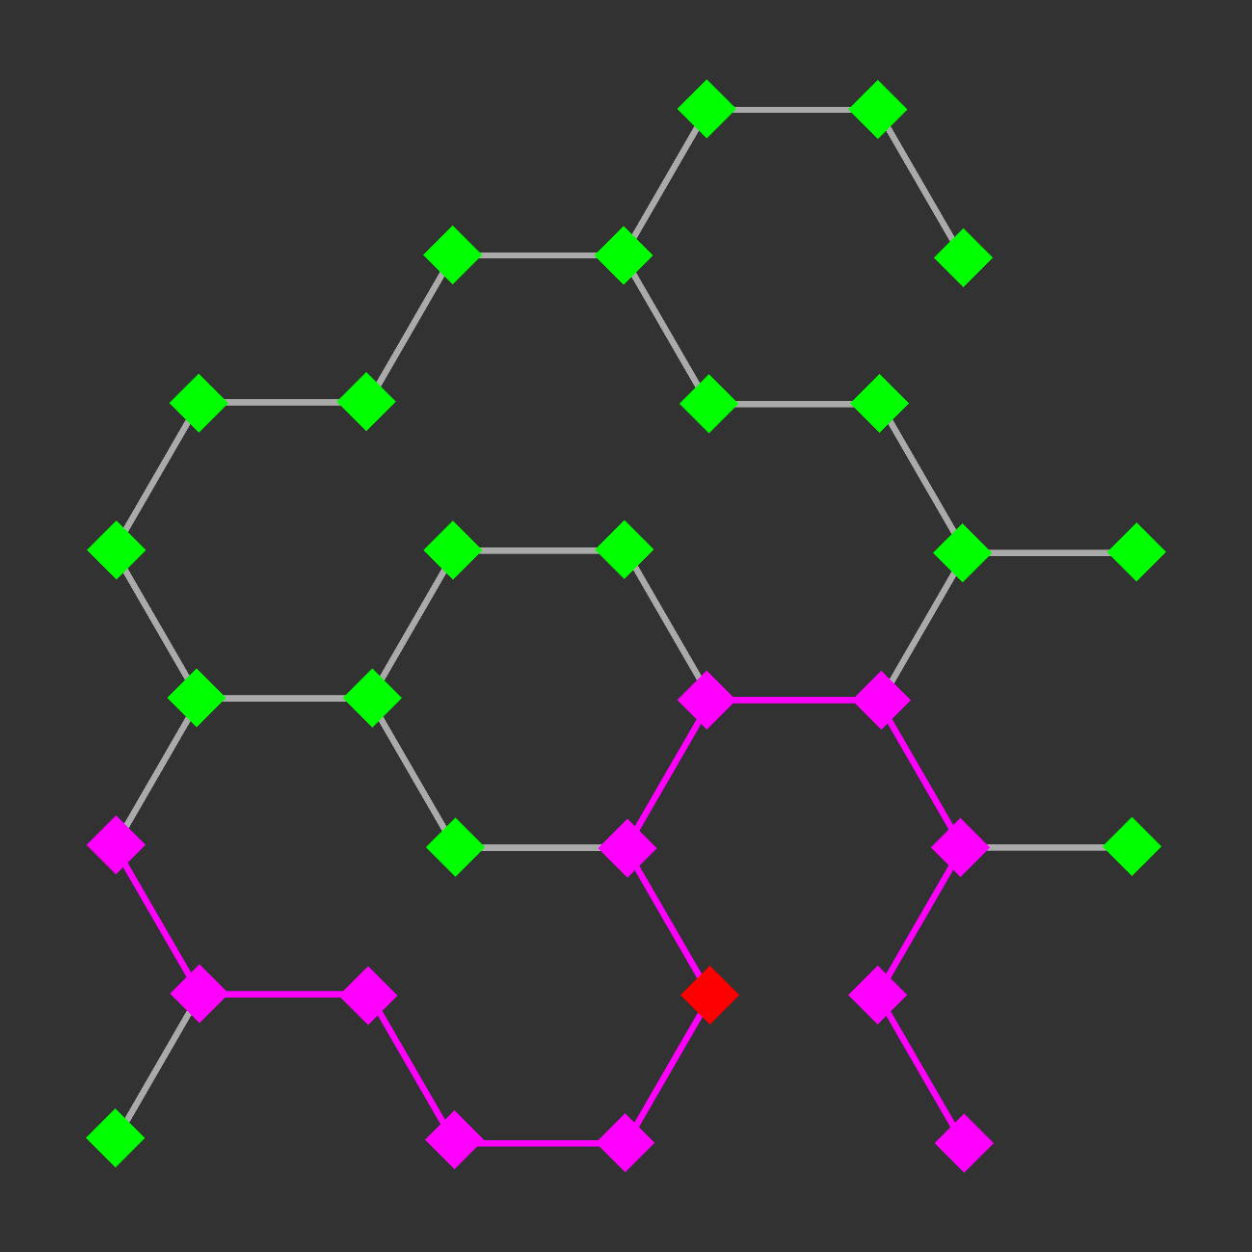
Network Visualization: Exploration And Analysis
Find paths between nodes:
- Shortest path
- Shortest path including or excluding another node or classification
- Path with greatest flux rate

Slide 15
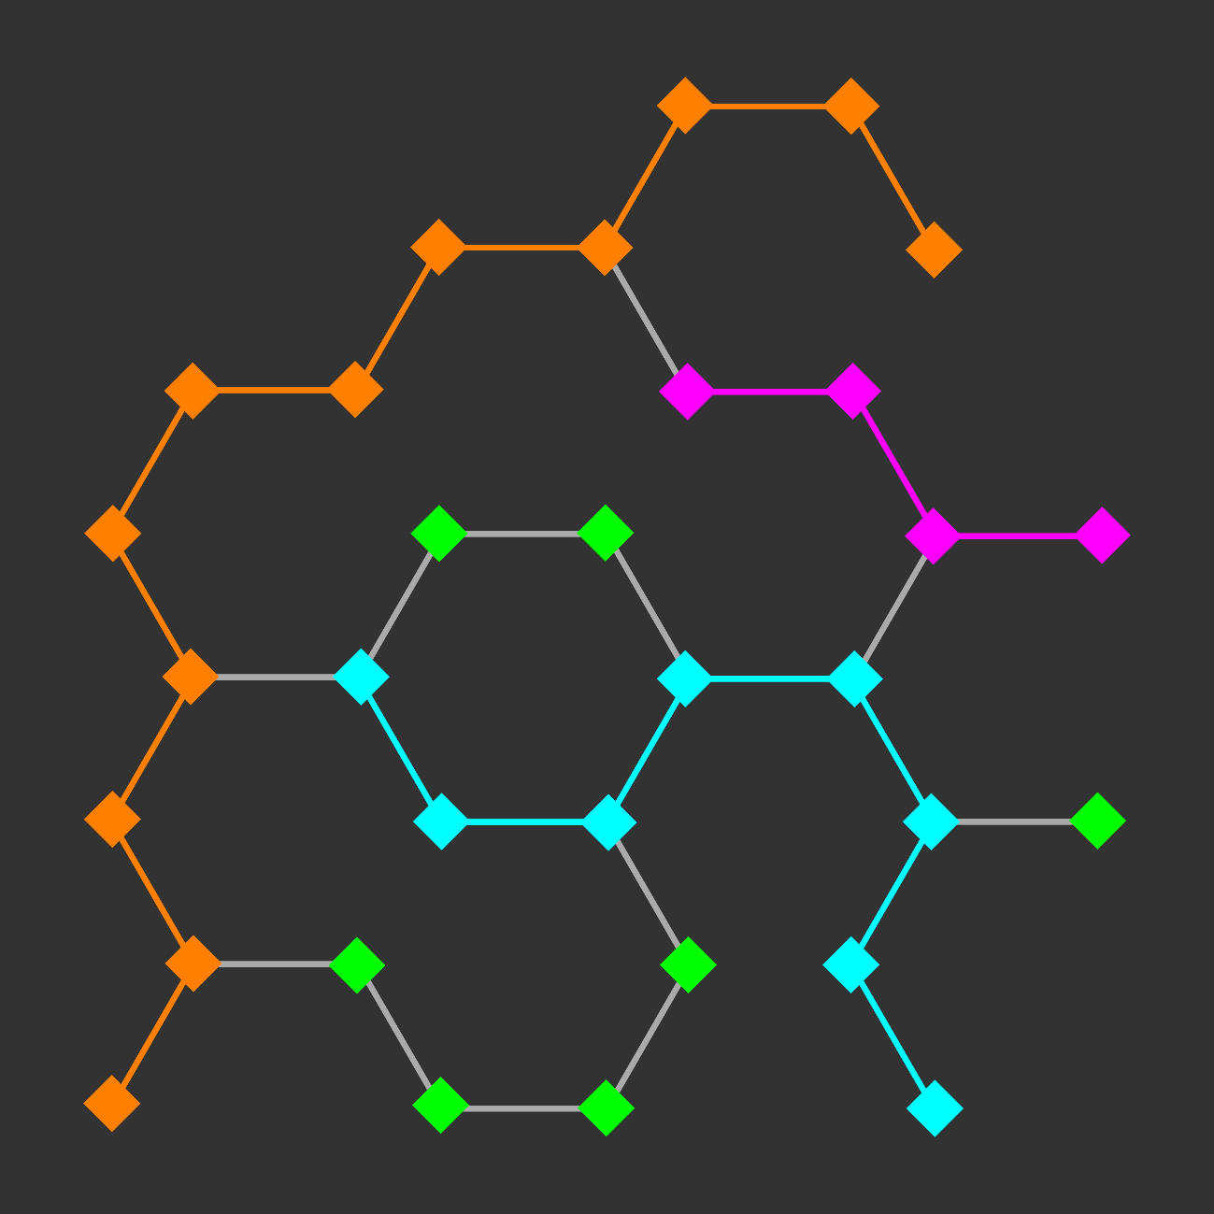
Network Visualization: Exploration And Analysis
Find paths between nodes:
- Shortest path
- Shortest path including or excluding another node or classification
- Path with greatest flux rate
- Specific metabolic pathway

Slide 16
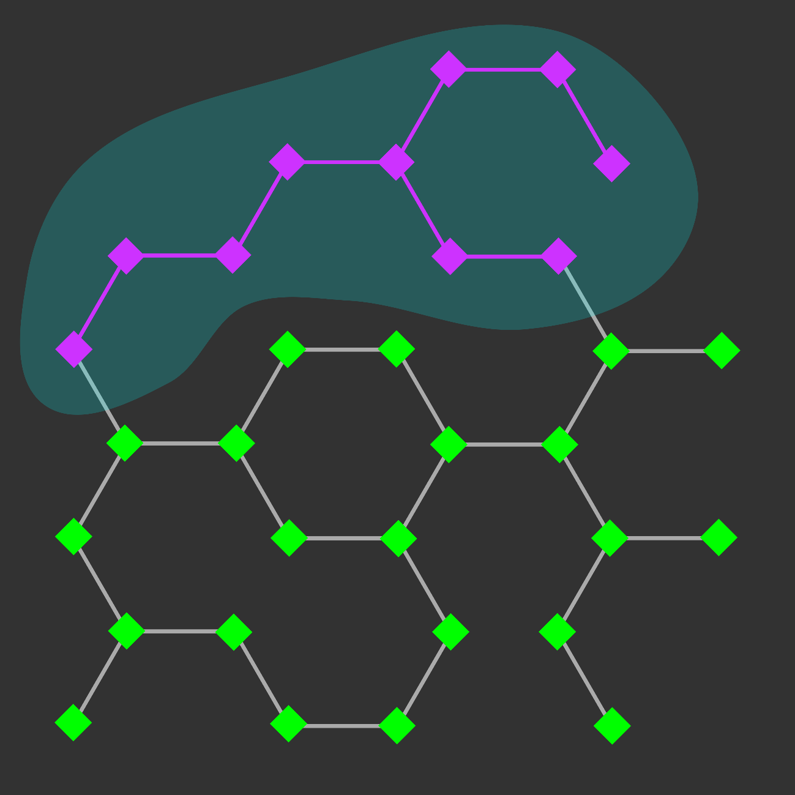
Network Visualization: Exploration And Analysis
Find paths between nodes:
- Shortest path
- Shortest path including or excluding another node or classification
- Path with greatest flux rate
- Specific metabolic pathway
- Specific cellular compartment

Slide 17
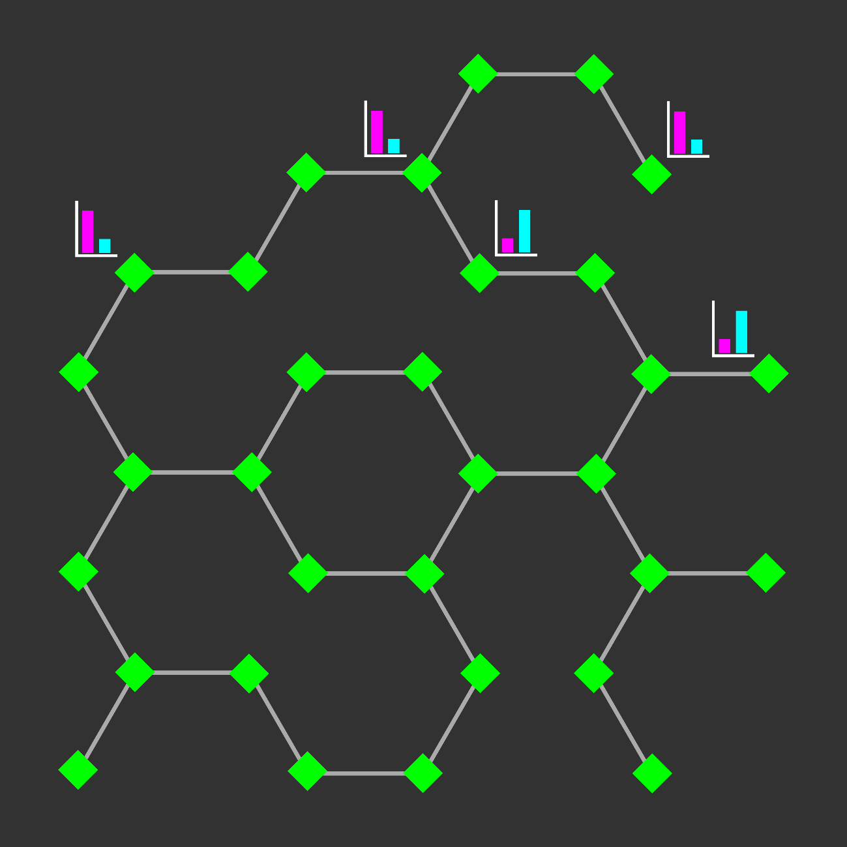
Network Visualization: Exploration And Analysis
Find paths between nodes:
- Shortest path
- Shortest path including or excluding another node or classification
- Path with greatest flux rate
- Specific metabolic pathway
- Specific cellular compartment
- Paths between all nodes with significant change in experimental data

Slide 18
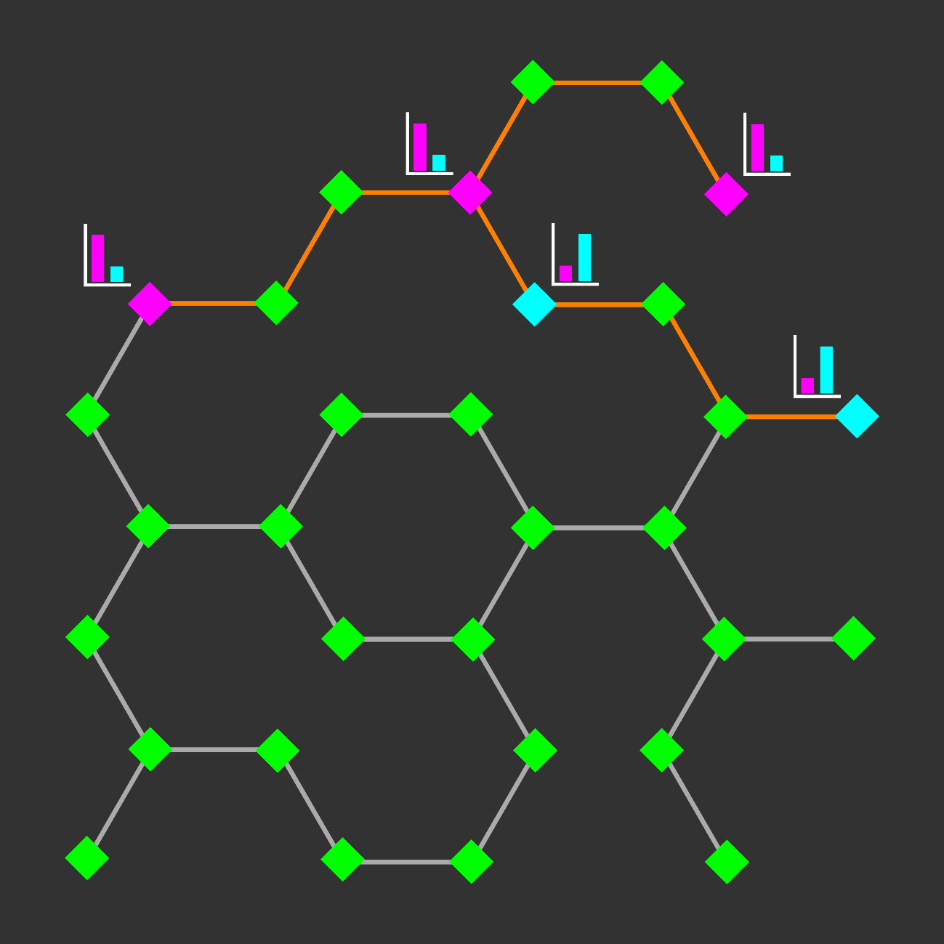
Network Visualization: Exploration And Analysis
Find paths between nodes:
- Shortest path
- Shortest path including or excluding another node or classification
- Path with greatest flux rate
- Specific metabolic pathway
- Specific cellular compartment
- Paths between all nodes with significant change in experimental data

Slide 19

Network Visualization: Exploration And Analysis
Find paths between nodes:
- Shortest path
- Shortest path including or excluding another node or classification
- Path with greatest flux rate
- Specific metabolic pathway
- Specific cellular compartment
- Paths between all nodes with significant change in experimental data
Recognize trends:
- Find common features of multiple nodes with significant change in experimental data

Slide 20
Network Visualization: Problems and Solutions

Slide 21
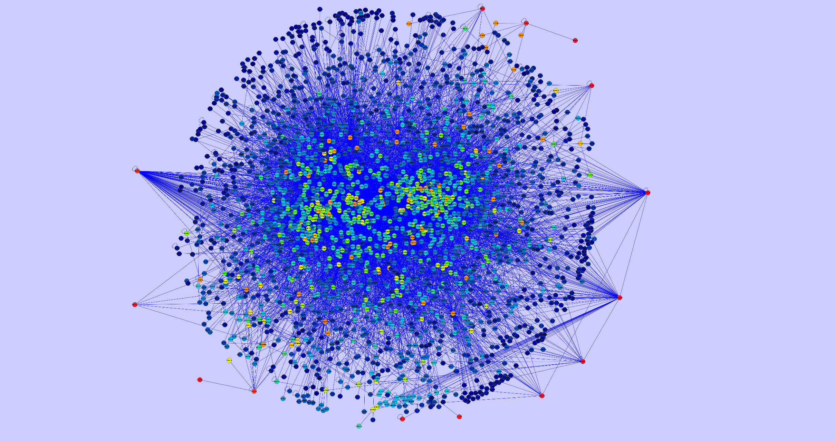
Gabor Ivan, Vince Grolmusz. Bioinformatics. 2010.

Slide 22
Network Visualization: Problems and Solutions
Scalability
Too many aspects to represent simultaneously.
Query-Based Exploration
Represent relevant subsets.
Interactive exploration.

Slide 23
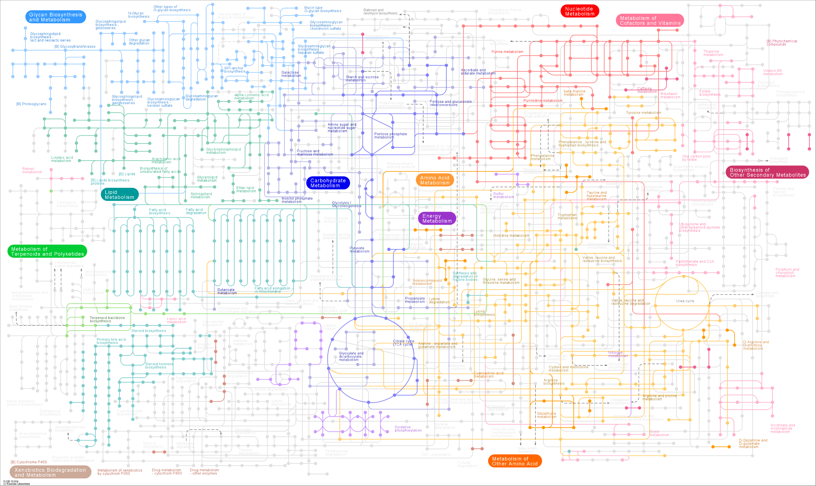

http://www.genome.jp/kegg/atlas.html

Slide 24
Network Visualization: Problems and Solutions
Scalability
Too many aspects to represent simultaneously.
Query-Based Exploration
Represent relevant subsets.
Interactive exploration.
Layout
Layout represents some aspects while distorting others.
Dynamic Layout
Represent network according to interest.

Slide 25
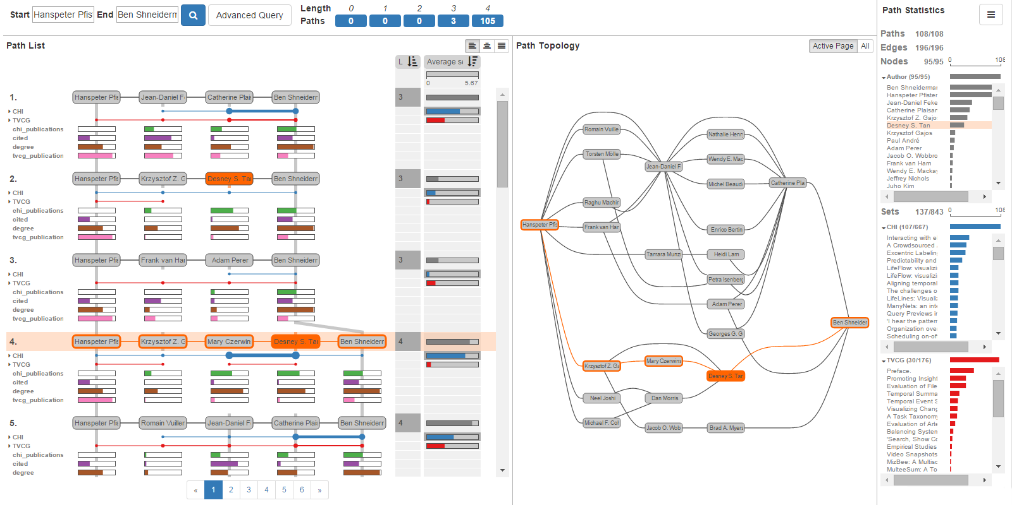
Network Visualization: Query-Based Exploration And Analysis
PathFinder
Christian Partl, … Alexander Lex. EuroVis. 2016.

Slide 26
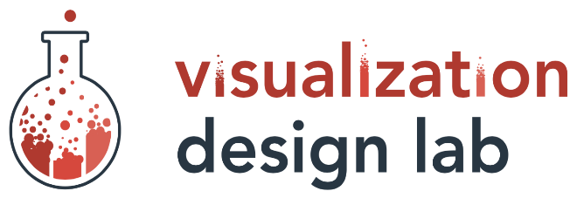



Acknowledgements
Courses:
Comp Prog for Biomed Info
Python
Brian E Chapman, PhD
Data Visualization
JavaScript, HTML, CSS
Alexander Lex, PhD
Teams:
Rutter Lab
Visual Design Lab
Support:
NIDDK T32 Training Program
Computational Metabolism
Mentors:
Alexander Lex, PhD
Assistant Professor
Jared P Rutter, PhD
Professor
Committee:
Current
Brian E Chapman, PhD
James E Cox, PhD
Adam L Hughes, PhD
Janet Iwasa, PhD
Former
Adam Frost, PhD
Christopher P Hill, PhD
Amnon Schlegel, PhD
Dennis R Winge, PhD

Slide 27





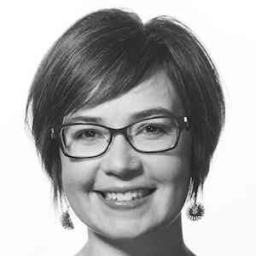
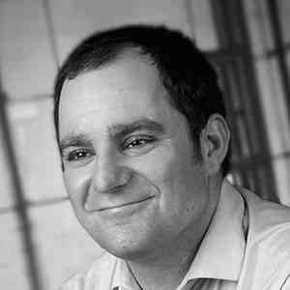
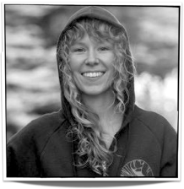





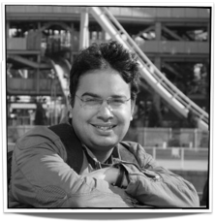
Ethan Kerzner
Alex Bigelow
Sean McKenna
Sam Quinan
Miriah Meyer
Alexander Lex
Nina McCurdy
Jimmy Moore
Asmaa Aljuhani
Carolina Nobre
http://vdl.sci.utah.edu/
Cameron Waller
Magdalena Schwarzl
Sunny Hardasani
Alexander Lex, August 2016

